Slide 1

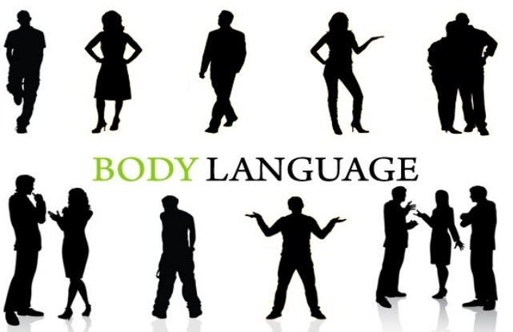
Nonverbal Communication/Body Language
Dr. Jukkalkar Syed Imtiaz
Department of English

Slide 2
Nonverbal Communication
Verbal communication is the use of words to convey a message. It includes written and spoken form of language.
Nonverbal communication is the use of body language to convey a message. One main form of nonverbal communication is body language.
Nonverbal communication include
facial expressions, 2) gestures, 3) paralinguistics such as loudness or tone of voice,
4) body language,
5) proxemics or personal space, 6) eye gaze, 7) haptics (touch), 8) appearance, 9) artifacts.

Slide 3
• Dominant body language: Dominating others.
• Emotional body language: Identifying feelings
Evaluating body language: Judging and deciding about something.
• Greeting body language: Meeting rituals.
• Open body language: Many reasons for being open.
Power body language: Demonstrating one's power.
• Ready body language: Wanting to act and waiting for the trigger.
• Relaxed body language: Comfortable and unstressed.
• Romantic body language: Showing attraction to others.
• Submissive body language: Showing you are prepared to give in.
Forms of Body Language :
• Aggressive body language: Showing physical threat.,
• Attentive body language: Showing real interest., ,
• Bored body language: Just not being interested ,
• Closed body language: Many reasons are closed.
Deceptive body language: Seeking to cover up lying or other deception.
• Defensive body language: Protecting self from attack

Slide 4
Uses of Body Language
Body language is also useful in investigations. One may try to give false information but the body language will reveal if the words uttered are true or false.
Body language plays a significant role in maintaining interpersonal relationship, particularly between the management and employees.
The body languages that will be of use in interpersonal relationships are:
Increased eye contact: Helps people to like each other
Friendly facial expression and smiles: Helps people to get motivated
Forward lean in posture : Helps people in making situations less formal
Body language is particularly important in group communication because it dominates the spoken word. It is a factor in human courtship as a subconscious or subtle method or communication between persons. Body language is also used in the field of selling, insurance companies, directly selling companies and international car showrooms.
Body language is used to express feelings. At times one may find it difficult to express his/her feelings through words. Body language comes in handy there- for example if someone wants to express anger, more than the words, the body language speaks louder and clearer. Experts believe that more than the words, the people read the body language to form an impression.

Slide 5
Body language in building industrial relations
Body language has a greater role to play in building industrial relations. It helps in
Motivating others
Team building
Negotiating styles
Reasons to study body language :
• Body language increases your attractiveness • Body language reveals your emotions
• Body language reduces confusing words / messages
• Body language improves your communication skills
• Body language gives you better first impressions

Slide 6
Improving Your Body Language
Keep your arms and legs open
Develop eye contact, but don't stare
Relax your shoulders
Nod when they are talking
Sit up straight
Lean but not too much
Smile and laugh
Keep your head up
Use your hands confidently
Keep a positive attitude

Slide 7
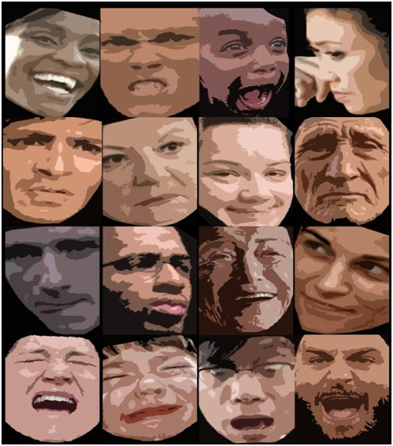
Parts of Body Language
1. Facial expression
Facial expressions are responsible for a huge proportion of nonverbal communication,
Consider how much information can be conveyed with a smile or a frown.
While nonverbal communication and behaviour can vary dramatically between cultures, the facial expressions for happiness, sadness, anger, and fear are similar throughout the world.

Slide 8

A Smile
A smile sends positive message. Smiling adds warmth anb an aura of confidence.

Slide 9
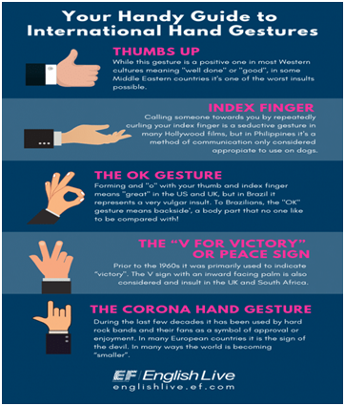
2. Gestures
Deliberate movements and signals are an important way to communicate without words.
Common gestures include
waving,
pointing,
and using fingers to indicate number.

Slide 10

Paralinguistic
Paralinguistic refers to vocal communication that is separate from actual language. This includes factors such as tone of voice, loudness, inflection, and pitch.
Consider the powerful effect that tone of voice can have on the meaning of a sentence. When said in a strong tone of voice, listeners might interpret approval and enthusiasm.
The same words said in a hesitant tone of voice might convey disapproval and a lack of interest.

Slide 11
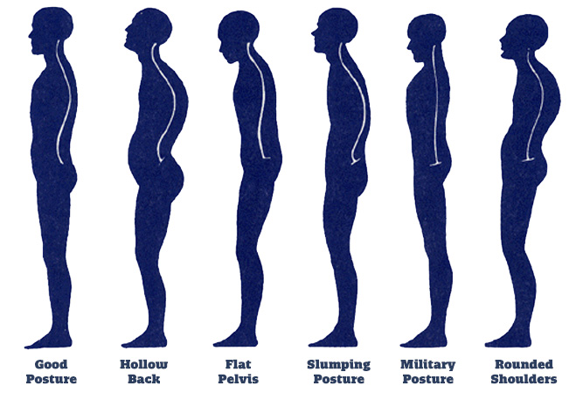
4. Body language and posture
Posture and movement can also convey a great deal on information.
Research on body language has grown significantly since the 1970's. While these nonverbal behaviors can indicate feelings and attitudes, research suggests that body language is far more subtle and less definitive than previously believed.

Slide 12
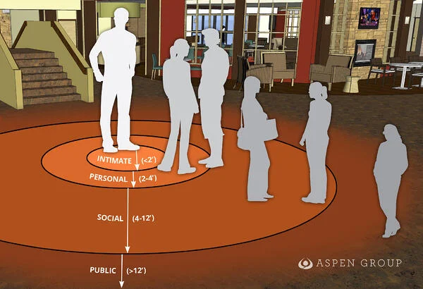
5. Proxemics
People often refer to their need for “personal space,” which is also an important type of nonverbal communication.
The amount of distance we need and the amount of space we perceive as belonging to us is influenced by a number of factors including social norms, situational factors, personality characteristics, and level of familiarity.

Slide 13

6. Eye Contact
Looking, staring, and blinking can also be important nonverbal behaviours.
When people encounter people or things that they like, the rate of blinking increases and pupils dilate.
Looking at another person can indicate a range emotions, including hostility, interest, and attraction.
Eye contact is an important aspect of social interaction, and it is something that many shy & socially anxious people have difficulty with. Often people with social anxiety describe looking someone in the eyes as anxiety-provoking and uncomfortable.

Slide 14
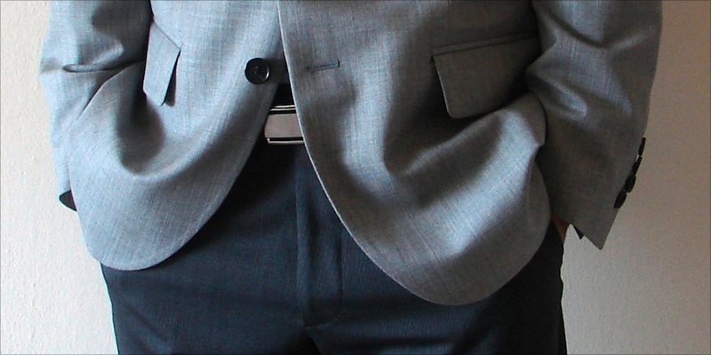
Developing Confidence With Correct Body Language
Avoid your pockets: You put your hands in your pocket when you are uncomfortable or unsure of yourself.
It is said a picture is worth a thousand words; now picture yourself, approaching a woman or a prospective client, walking into a party or your boss. How do you look? What message do you communicate the moment you walk into a room? What are your eyes, hands and shoulders saying? What information can people gather about you before you ever say a word?

Slide 15


3. Keep your eyes forward :
Eye contact is one of the important ways to show confidence in body language.
2. Don’t Fidget
Fidget is clear sign of nervousness. A person who can’t keep still, is a man who is worried, disturbed, tensed and certainly not confident.

Slide 16
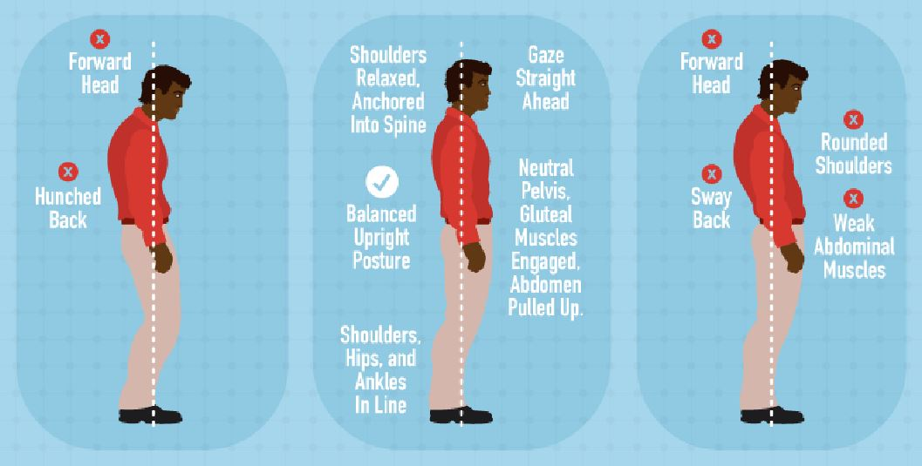
4. Stand up straight with your shoulders back
Standing up straight is one of the most important tips to project confidence through body language. It can be a difficult if you've been a sloucher all your life. Standing up straight is perhaps the most important means of communicating confidence. Concentrate on pushing your shoulders back slightly when standing and walking, Try it in front of the mirror and you'll be surprised how much more confident it makes you look.

Slide 17
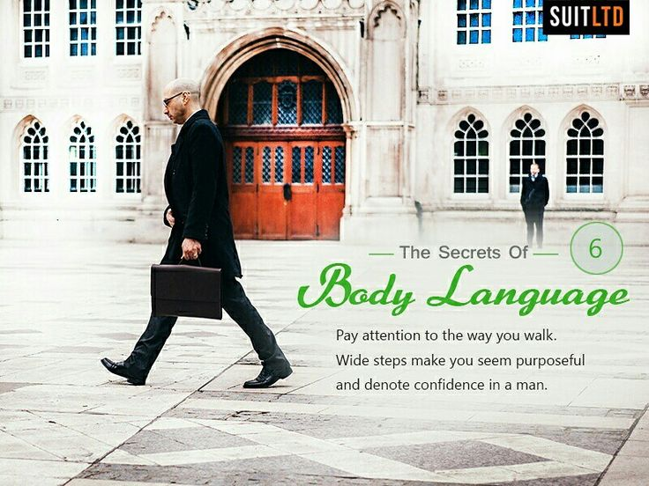
5. Take Wide Steps
A confident man will never walk like "scurrying." "creeping" or "sneaking," so pay attention to the way you walk. If you want to show confidence with body language you have to take large steps. Wide steps make you seem purposeful and suggest confidence in persons.

Slide 18
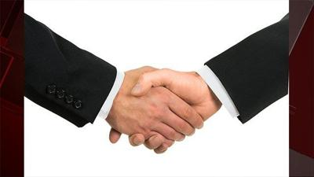
6. Firm Handshake
While shaking hand with someone, grip the other person's hand firmly and confidently, While shaking hands with someone you've already met, you might even consider the two hand grab: placing your free hand on the other person's elbow adds warmth and enthusiasm to the handshake. A handshake is not a contest. Therefore don't cry to crush the other person's hand and don't hold on too long.

Slide 19
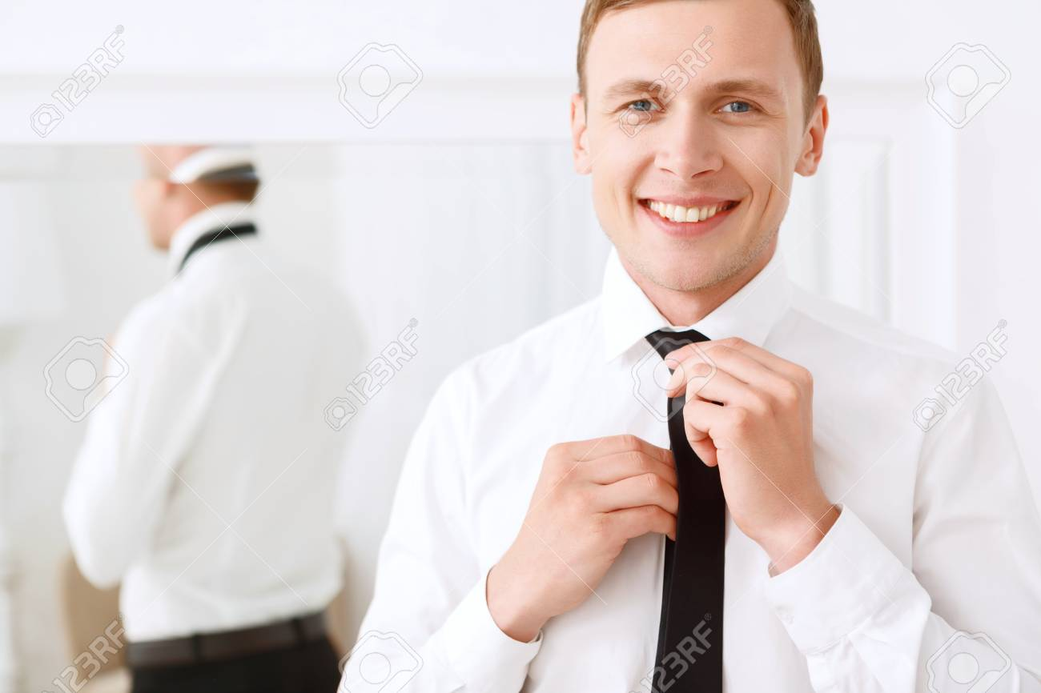
7. Proper grooming
Grooming is an essential component of communicating confidence through body language. You should aim at making your hair, face and even your smell to work for you and not against you. Try to experiment with new products to find the ones that work for you.

Slide 20
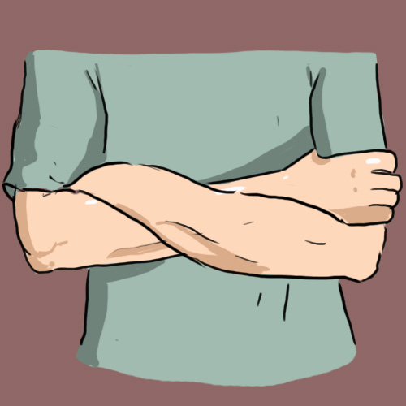
8. Don’t Cross your arms when socializing
Crossing your arms is a protective posture. You do it when you feel are cold, nervous or on guard. Do not be like the guard at the door to a club. Your job is to look likeable, open and confident. So keep your arms uncrossed.

Slide 21


